Slide 1
Team 5 Expedia Hotel Recommendations Which hotel type will an Expedia customer book? Ruchira R. Patil Ziqing Zhou

Slide 2
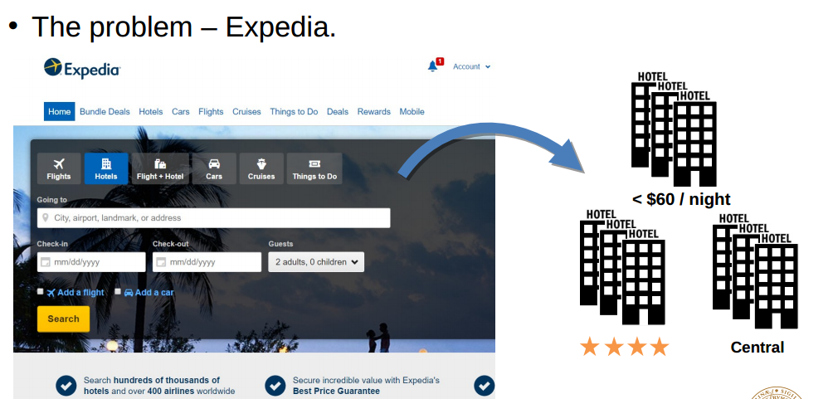
Use Cases
Use Case 1 :
Customer gets the hotel recommendations for different user input like userId, Destination etc
Use Case 2 :
Customer gets the hotel recommendations based on historical data of hotel bookings of other customers
Use Case 3 :
Data Scientist can visualize the data for initial data analysis for machine learning.
Use Case 4 :
Data analyst / Business Analyst able to visualize the data on interactive dashboard for Business Intelligence

Slide 3
Methodology (how/what do you propose to do);
User Based Recommendations :- Using MapReduce.
Recommendations based on historical Data :- Here we will be developing a machine learning model which will predict which hotels (hotel clusters ) user is likely to book and recommend those hotels to users. Machine Learning : Decision Trees or Logistic Regression/ Collaborative Filtering)
Descriptive Analysis :- Querying Data and storing result in Data ware house. Fetching data from Data ware house visualizing on web dashboard.

Slide 4
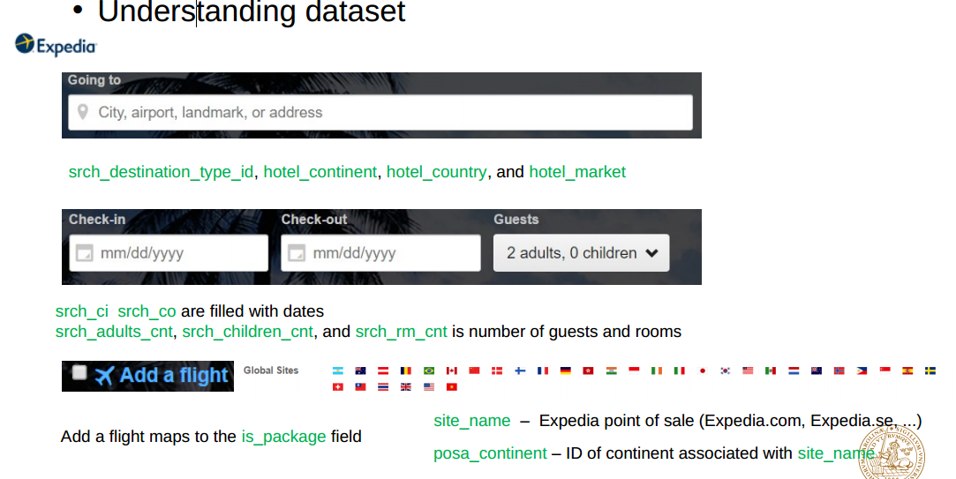
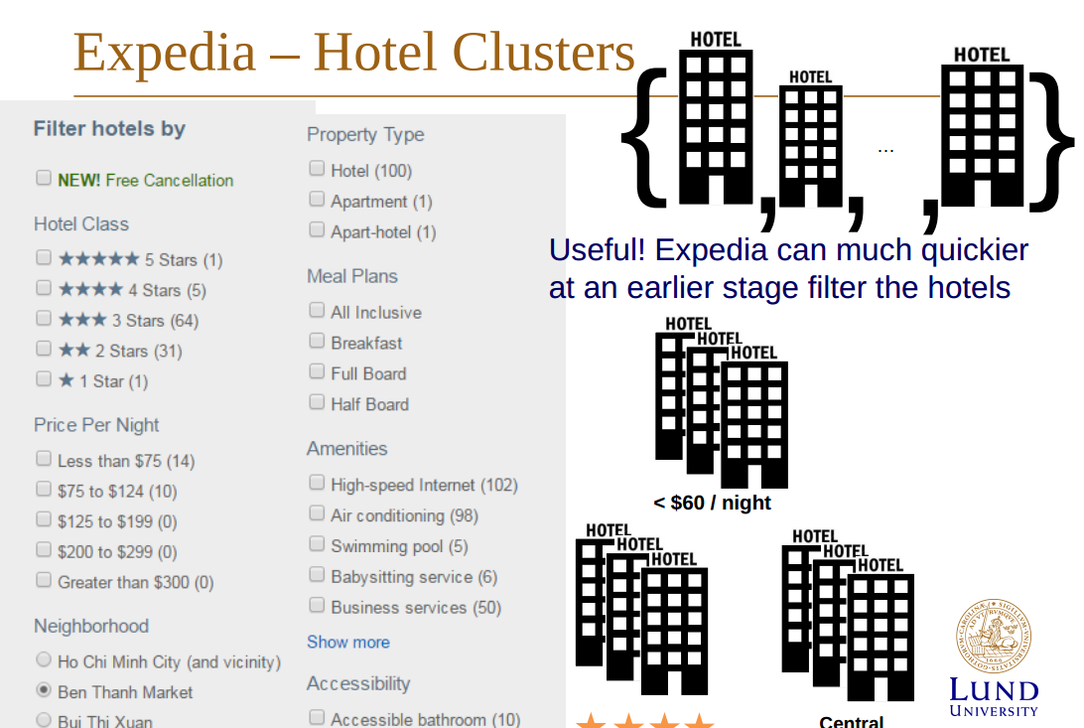
Data sources, enumerating the magnitude of the data that you will process;
Expedia – dataset(Kaggle)
(4.09GB, 37670294 records)
24 column in training
• 22 column in testing (no is_booking, no hotel_cluster)(424MB) • Most of the columns are integers or floats • Output hotel cluster ID integer range from 1-99

Slide 5
Milestones/sprints (approximately one week to ten days between each);
Running Project on Spark Clusters with all big data. Preparing final project presentation
Data cleaning, Creating clusters and Spark development environment set up , finalizing which machine leaning algorithm to use
Implementing MapReduce with Spark, Implementing Machine learning with MLLIb.
Building Web Dashboards using Play Framework,
Configuring the spark cluster on AWS
Sprint 4
Sprint 3
Sprint 2
Sprint 1
11.10
11.17
11.24
12.1
12.8

Slide 6
What will you program in Scala and where will your code repository be?
Data Processing in Spark (MaprReduce,Machine Learning)
Scala playframework to create BI dashboards.
Unit Tests using Scala Test Framework for each of our use case
https://github.com/Ruchi2729/Scala-Final-Project

Slide 7
Acceptance criteria (how will I know that you have achieved what you set out to do?);
Get the recommendations based on existing user information. Each existing user gets at least 1 valid hotel (cluster) recommendation based on varying inputs.
Get the recommendations for any user based historical data of other users. Here we will be developing a machine learning model which will predict which hotels (hotel clusters ) user is likely to book and recommend those hotels to users. We wish to achieve at least 51 % of accuracy with our predictive model

Slide 8
Goals of the project (what do you expect to achieve and accomplish).
Our goal of this project is to predict the booking outcome (hotel cluster) for a user event, based on their search and other attributes associated with that user event.
Prediction and recommendation using Machine learning and MapReduce consuming Spark APIS.
As our data consists of almost 37 million records, the goal of the project is also to process this big data on spark clusters.

